Slide 1
Project Seminar 1 Report
Browser Automation with Natural Language Instructions Utilizing Multimodal Methods
Adrián Bindas

Slide 2
Thesis context and assignment
Motivation
  Pivot to automated interactions with web pages using LLM web agents
  Web agents and benchmarks suffer from multiple problems
  Robustness is limited by the grounding methods
Tasks
  Survey existing grounding methods, datasets and benchmarks
  Extend existing dataset
  Propose novel grounding method optimizing for inference speed and low resources
  Validate and compare novel method on the dataset

Slide 3
The thesis was based mainly on these papers
MIND2WEB: towards a generalist agent for the web
  One of the first specialized grounding methods
GPT-4V(ision) is a generalist web agent, if grounded
  Grounding methods are a significant bottleneck for web agents
Navigating the Digital World as Humans Do: Universal Visual Grounding for GUI Agents
  Grounding method based purely on visual input

Slide 4
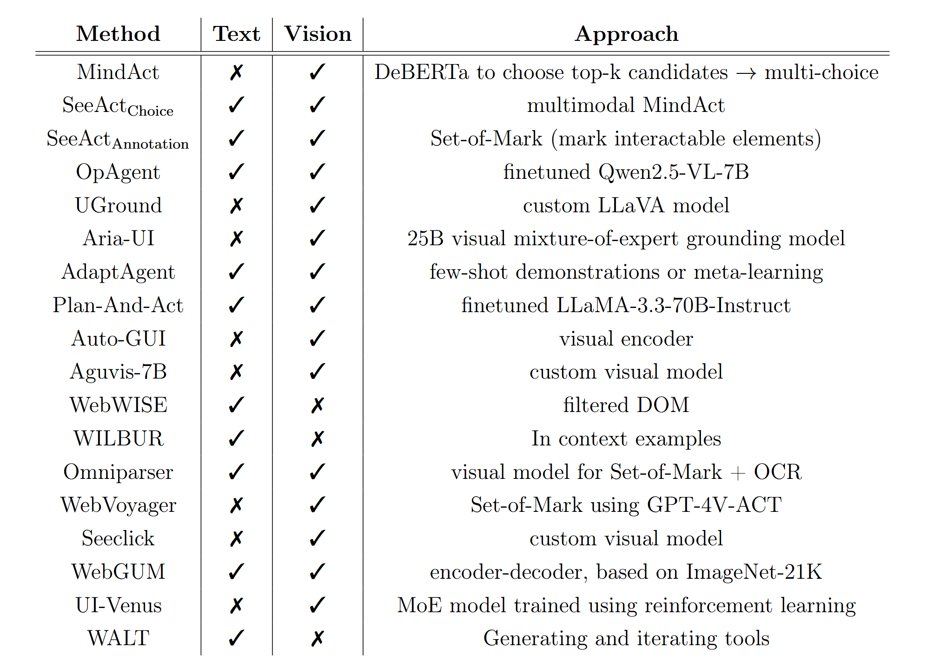
What goals have been reached…
25+ existing approaches have been surveyed and summarized

Slide 5
What goals have been reached…
The thesis introduction
  Motivation
  Terminology
  Previous works
  Problems of agentic workflows
The thesis methodology
  Candidate generation
  Action prediction
    Text-first approach
    Image-first approach

Slide 6
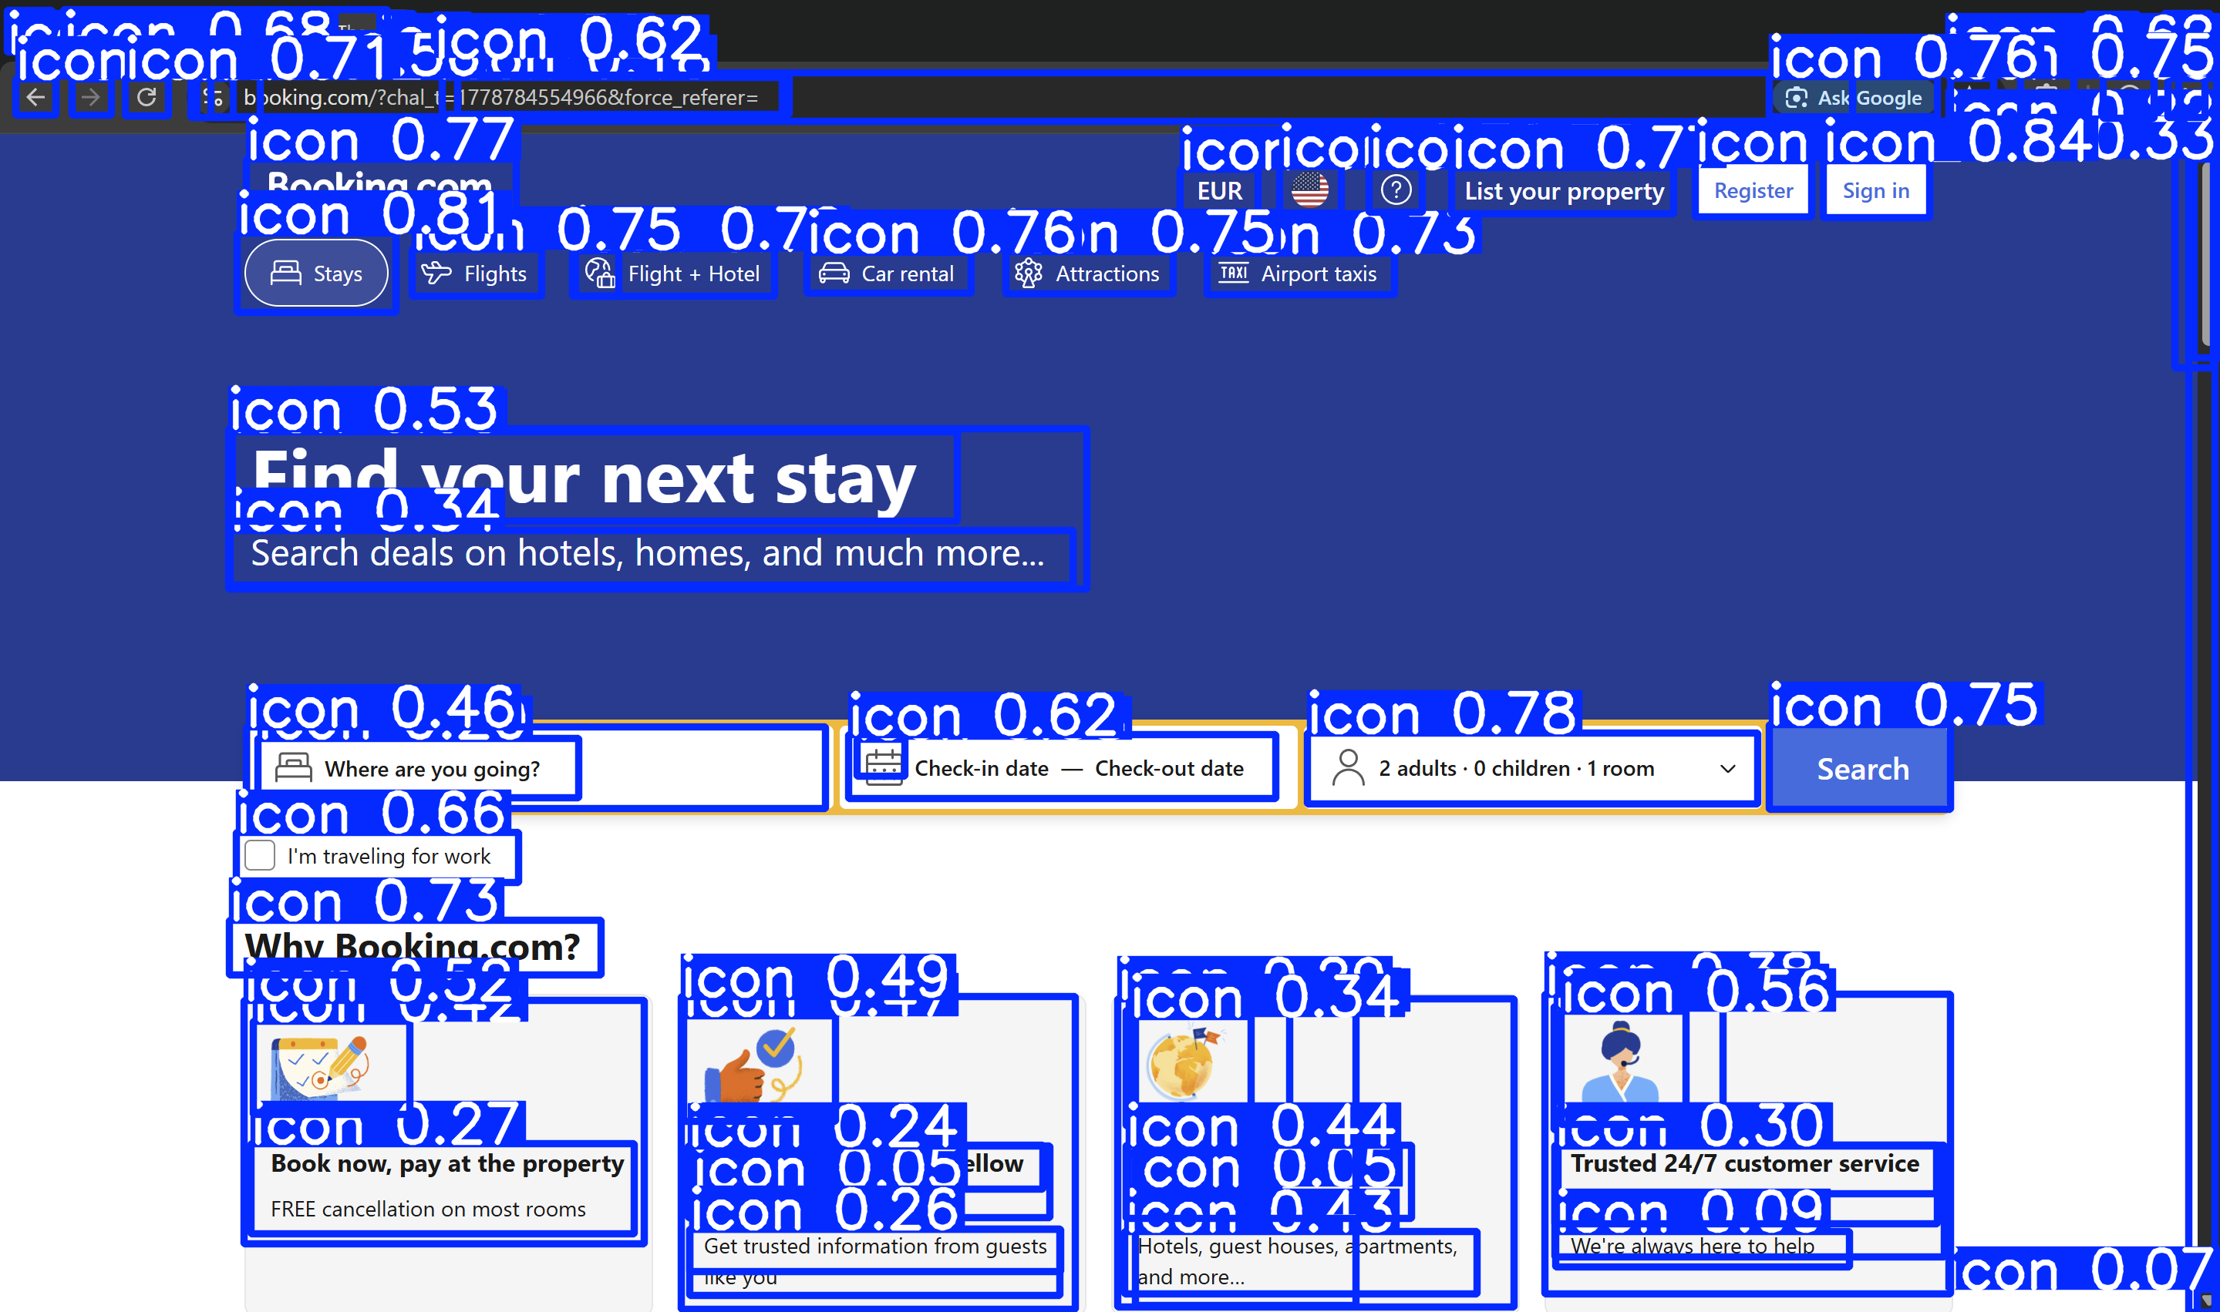
What goals have been reached…
Set of online web sites for preliminary testing
Library demos
  Playwright – access website, download DOM and parse
  Transformers – download model and analyze screenshot locally
  Ultralytics – detect UI
  elements using YOLO model

Slide 7
…what is yet to come…
May – June 2026 – Proof of concept of the novel method
July 2026 – Dataset collection
August – September 2026 – Implementation of the novel method, finetuning
Winter 2026 - Evaluation of implemented method, comparison with existing methods
Spring 2027 - Writing and finishing paper

Slide 8
…and what are the limitations
The volatility of online websites
The lack of unified benchmark for web agents
LLM finetuning is resource heavy
Only a small part of existing models is open source, many are proprietary

